Slide 1
Deep Reinforcement Learning (DRL) Agents
Shubhendu Kumar Singh

Slide 2
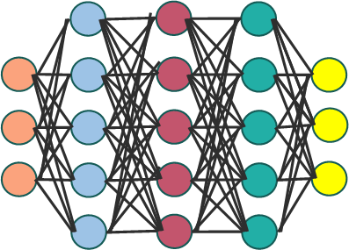
DQN Agent
Online Q Network
Replay Buffer
(S₁, A₁, R, S₂)
Q(S₁, A₁)
(S₂, A₂, R, S₃)
S₁
Q(S₁, A₁’)
Q(S₁, A₁”)
(S₃, A₃, R, S₄)
Back Propagation
- - - - - - - - - - -
Loss= Mean Squared Error (R + γmax_{A} Q(S₂, A₂) - Q(S₁, A₁))
- - - - - - - - - - -
S₂
R + γmax_{A} Q(S₂, A₂)
Target Q Network

Slide 3
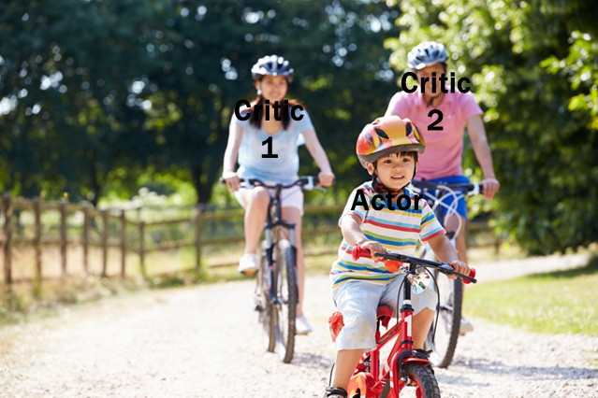
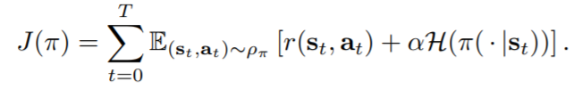
Soft Actor-Critic (SAC) Agent:
Key Concept: SAC is a model free, off-policy, actor-critic algorithm designed for continuous action spaces. It is designed to be:
Sample efficient (reuses past experiences via replay buffer),
Stable (with entropy regularization to encourage exploration),
And robust in high-dimensional action spaces and sparse rewards
It blends ideas from:
Actor-Critic methods (has separate actor and critic networks),
Q-learning (uses value estimates),
Maximum Entropy RL (adds entropy term to reward for better exploration).
Main goal of SAC:
SAC Maximizes:
r(s_{t}​,a_{t}​): reward
H: entropy of the policy (how random it is)
α: entropy temperature — balances exploration (entropy) and exploitation (reward)

Slide 4
Soft Actor-Critic (SAC) Agent (5 networks in total, 4 in use):
Policy Network (Actor):
The Policy Network (Actor) gets the current state s and outputs:
A mean μ(s)
A standard deviation σ(s)
It samples an action a using:
a∼tanh(N(μ(s),σ(s)))
Critic Networks (Q₁, Q₂):
Both Q-Network 1 and Q-Network 2 receive:
The same state s
The same action a
Each critic predicts a separate Q-value
Q₁(s,a), Estimates Q₁(s,a) expected return of action a in state s.
Q₂(s,a), Same as above, independent, helps reduce overestimation bias.
These are independent networks with different weights.
Target Networks (Q₁, Q₂):
Delayed versions of Q1 and Q2 used to stabilize training.
Updated using Polyak averaging:
θ′←τθ+(1−τ)θ′

Slide 5
Soft Actor-Critic (SAC) Agent (5 networks in total, 4 in use):
Training Process:
1. Collect Experience:
Use current policy π to act in the environment.
Store (s,a,r,s′,done) in the replay buffer
2. Sample Mini-Batch:
Randomly sample batch of transitions from replay buffer.
3. Critic Updates:
Compute target Q-value:
y=r+γ(1−done)[min(Q₁​(s′,a′),Q₂​(s′,a′))−αlogπ(a′∣s′)]
Update both Q₁ and Q₂​ by minimizing:
L=MSE(Q(s,a),y)
4. Actor Updates:
Improve the policy by minimizing:
J_{π​}=E_{s∼D}​[E_{a∼π}​[αlogπ(a∣s)−Q(s,a)]]
Encourages choosing actions with high Q-value and high entropy.
5. Update Target Q Networks:
Soft update using Polyak averaging:
θ_{target}​←τθ+(1−τ)θ_{target​}
Replay Buffer
(s, a, r, s’)
(s’, a’, r’, s’’)
- - - - - - - - - - -
- - - - - - - - - - -
- - - - - - - - - - -

Slide 6
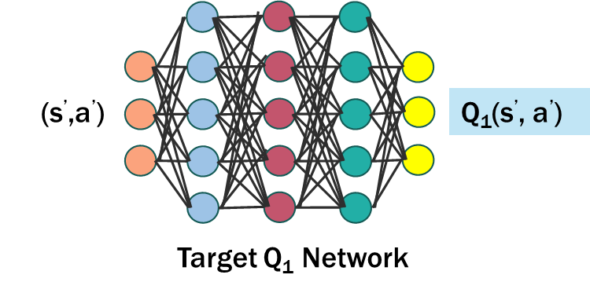

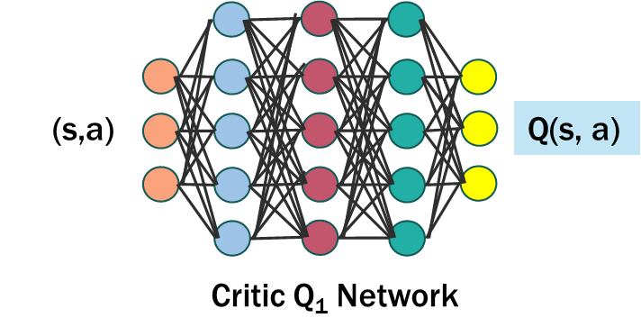

SAC Agent: Training
Replay Buffer
Actor Network
(s, a, r, s’)
Loss=E_{s∼D}​[E_{a∼π}​[αlogπ(a∣s)−Q(s,a)]]
(s’, a’, r’, s’’)
- - - - - - - - -
s
a∼tanh(N(μ(s),σ(s)))
Back Propagation
- - - - - - - - -
Back Propagation
y=r+γ(1−done)[min(Q₁​(s′,a′),Q₂​(s′,a′))−αlogπ(a′∣s′)]
Loss = MSE(Q(s,a),y)

